Slide 1
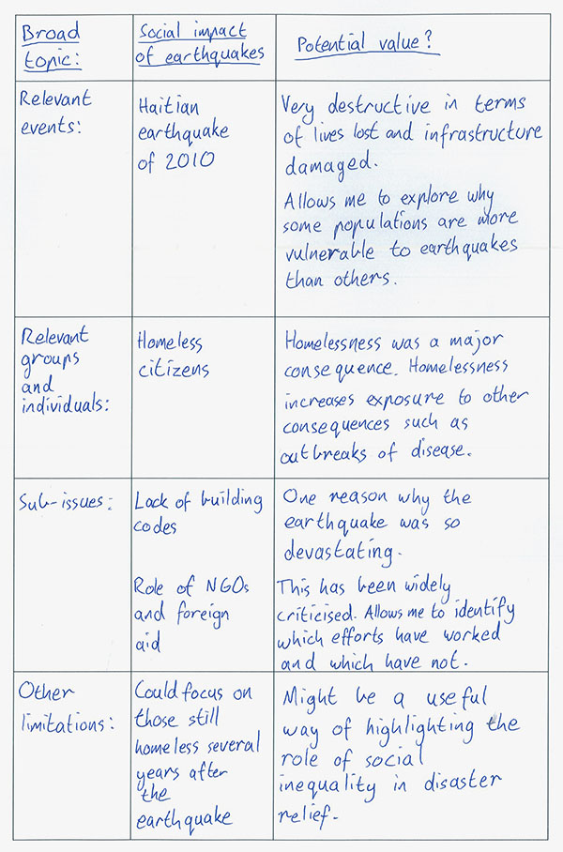
Narrowing down your topic – Research Questions

Slide 2
Understandings of Discourse
(Thornbury, 2010, 270)
  Discourse as connected text
  Discourse as language in use
  Discourse as social practice (cf. Fairclough 1989)

Slide 3
Cohesion
“Cohesion expresses the continuity that exists between one part of the text and another. It is important to stress that continuity is not the whole of texture. The organization of each segment of a discourse in terms of its information structure, thematic patterns and the like is also part of its texture … no less important than the continuity of one segment to another.” (Halliday and Hasan, 1976, 299)
Cohesion → structure
Coherence → logical connection

Slide 4
Working with a corpus
Have a try: https://www.english-corpora.org/
Login: regina.holze@uni-passau.de
Password: ThisIsMyPassword4CL
You can try it on your own with my account or just register your own, it’s free of charge and might be useful anyways for potentially comparing your own corpus.

Slide 5
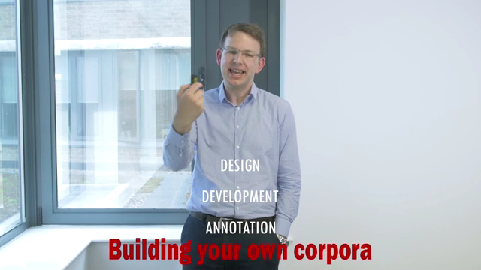
Note: Please read Reppen 2010 for information on the process of compiling your own corpus! (cf. Syllabus, text is on StudIP)
When working with a corpus…
Dr. Vaclav Brezina, Lancaster University (UK), 2020

Slide 6
Conceptualising your own corpus
What should your corpus encompass?
Which kind of corpus is it?
Where do you plan to start your search for corpus data?
Is the data suitable for answering the question?
Is it representative?
For next week: Please decide for a research question and which corpus might be suitable. Start with saving the first corpus data (.txt files, cf. Reppen 2010) and report any difficulties in class.

